Slide 1
INFORMATION SYSTEMS 3A SOFTWARE PROCESSES

Slide 2
Topics to be covered
Software process models
Process activities
Coping with change
Process improvement

Slide 3
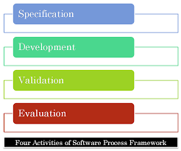
Software process
Specification
•defining what the system should do;
Design and implementation
•defining the organization of the system and implementing the system;
Validation
•checking that it does what the customer wants;
Evolution
•changing the system in response to changing customer needs.

Slide 4
Software process descriptions
Products: which are the outcomes of a process
activity;
Roles: which reflect the responsibilities of the people involved in the process;
Pre- and post-conditions: which are statements that are true before and after a process activity has been enacted or a product produced.

Slide 5
Plan-driven and agile processes
Plan-driven processes :processes where all of the process activities are planned in advance and progress is measured against this plan.
Agile processes: planning is incremental and it is easier to change the process to reflect changing customer requirements

Slide 6
Types of Process Models
Waterfall
Incremental
Integration and configuration

Slide 7
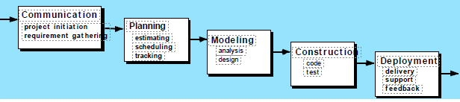
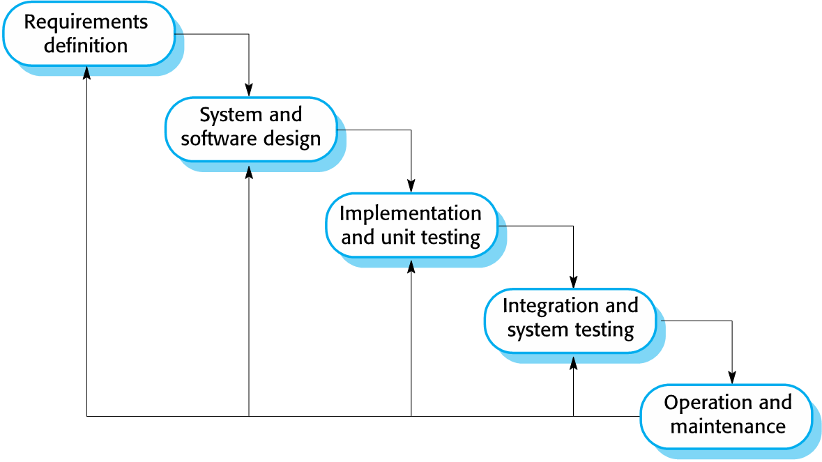

Waterfall Model

Slide 8
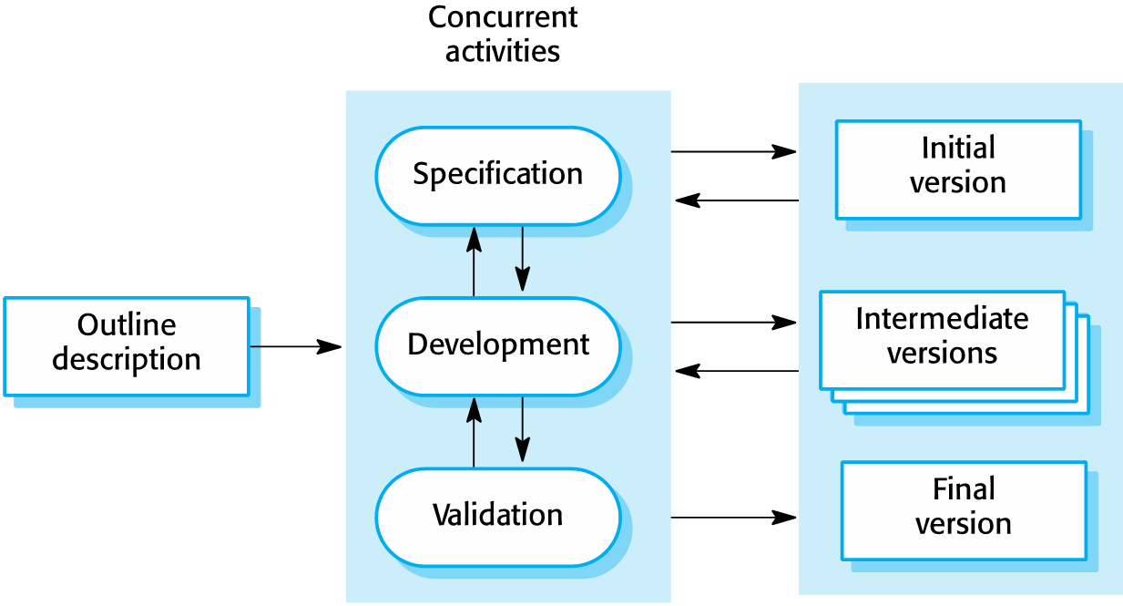
Incremental development Model

Slide 9
Characteristics of incremental
Most common approach
Used in agile, plan-driven or hybrid
Allows for discovery of functionality

Slide 10
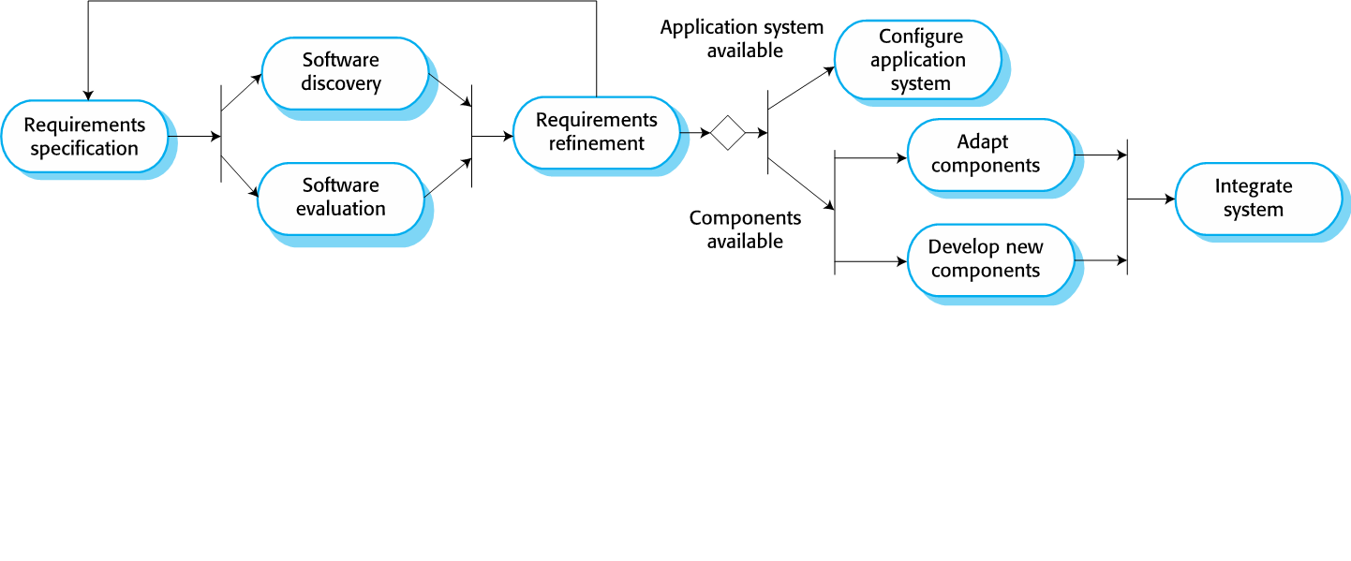
Integration and configuration
Based on software reuse where systems are integrated from existing components or application systems (sometimes called COTS -Commercial-off-the-shelf) systems).

Slide 11
Advantages and disadvantages
Reduced costs and risks as less software is developed from scratch
Faster delivery and deployment of system
But requirements compromises are inevitable so system may not meet real needs of users
Loss of control over evolution of reused system elements

Slide 12
Process activities
The activities needed to develop software
Specification
Development
Validation and
Evolution
The process model organizes these activities

Slide 13
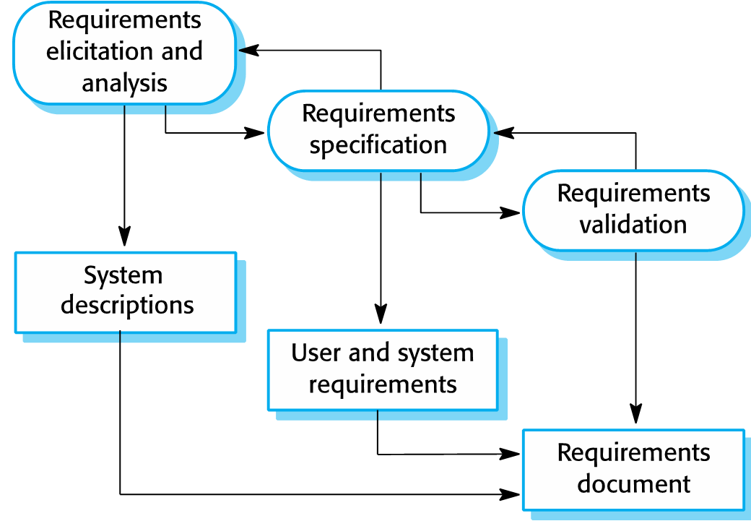
Software specification
The requirements engineering process

Slide 14
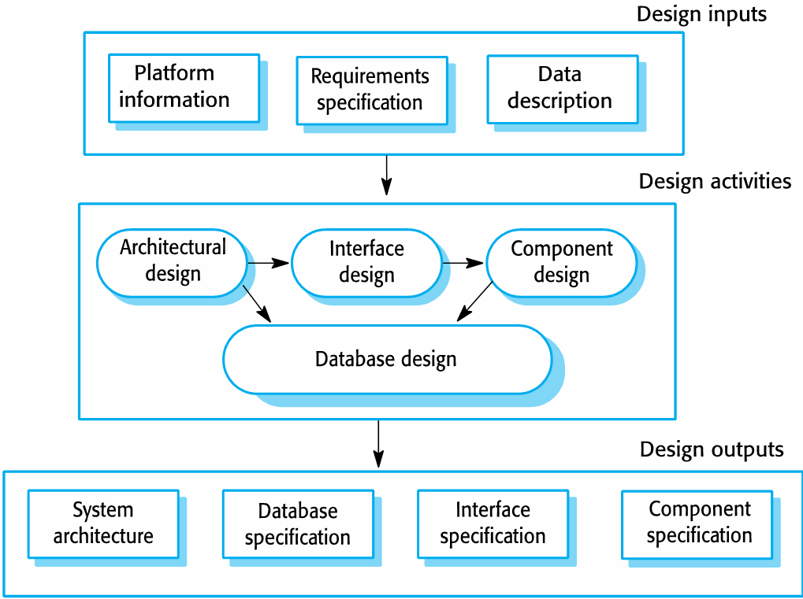
Design and implementation
Sommerville, 2016

Slide 15
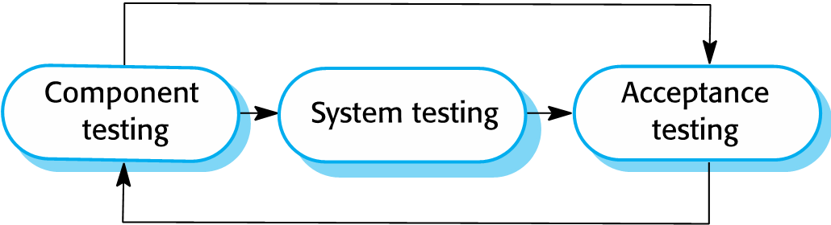
Validation
Peters, 2014

Slide 16
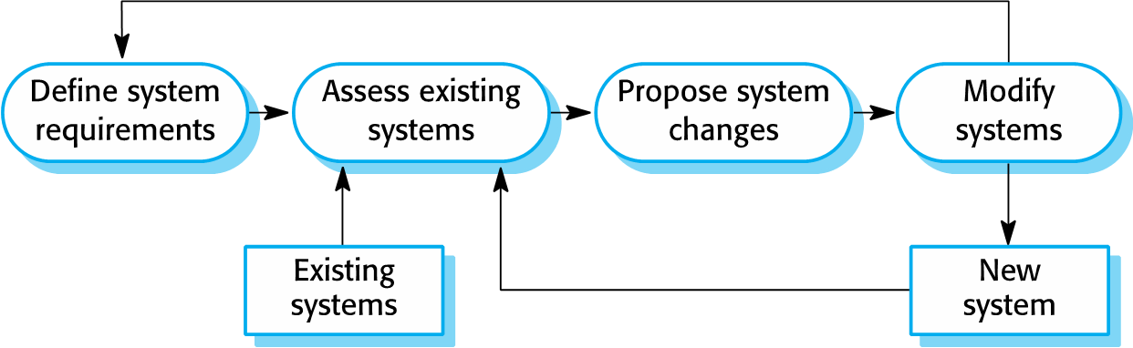
Software evolution
Sommerville, 2016
Evolutionary process model types:
Prototyping
Incremental delivery

Slide 17
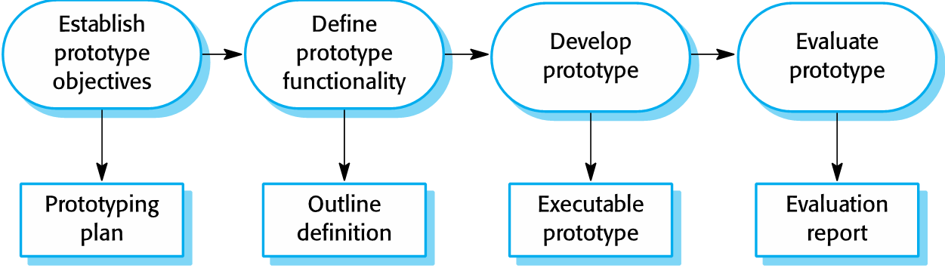

Prototyping

Slide 18
Benefits of prototyping
Improved system usability.
A closer match to users’ real needs.
Improved design quality.
Improved maintainability.
Reduced development effort.

Slide 19
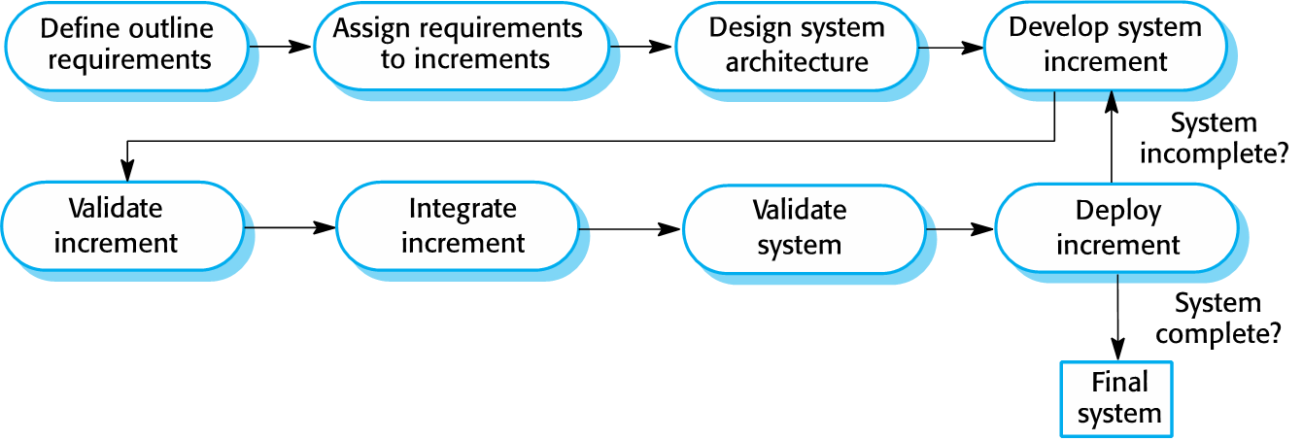

Incremental delivery

Slide 20
Incremental development and delivery
Incremental development
Develop the system in increments and evaluate each increment before proceeding to the development of the next increment;
Normal approach used in agile methods;
Evaluation done by user/customer proxy.
Incremental delivery
Deploy an increment for use by end-users;
More realistic evaluation about practical use of software;
Difficult to implement for replacement systems as increments have less functionality than the system being replaced.

Slide 21
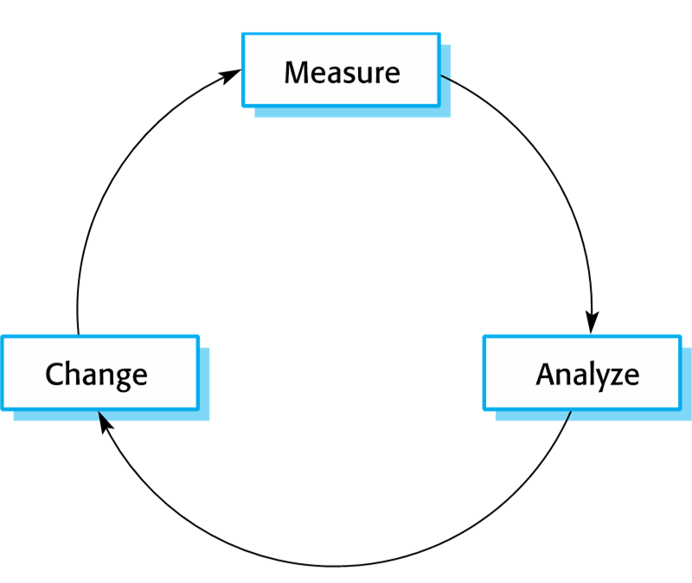
Process improvement
Process metrics
Time taken for process activities to be completed
E.g. Calendar time or effort to complete an activity or process.
Resources required for processes or activities
E.g. Total effort in person-days.
Number of occurrences of a particular event
E.g. Number of defects discovered.

Slide 22
Capability maturity levels

